Slide 1
Urban Priesthood Alliance
Roundtable of Leaders Conference
Featuring
Peter Odanga
Director Word of Life Kenya
Saturday, April 28, 2012

Slide 2
What is the
Urban Priesthood Alliance?
We are…
  The first graduating Cohort out of the Biblical Seminary Urban Master of Divinity Program
  An eclectic group of leaders from various traditions all with a burden for African American Urban Churches
  Primarily interested in seeing missional theology grab the hearts and minds of those ministering in the city
  Not a Church!

Slide 3
The Urban Priesthood Alliance
We are a group of 15 leaders from various denominations and affiliations. (mostly African American)
  COGIC, Baptist, Southern Baptist, Non-Denominational, Anabaptist, Brethren, African Methodist Episcopal.
We are a group with over 200 Years of ministry ‘leadership’ experience
We are made up of Lead Pastors, Bi-Vocational Pastors, Full Time Pastors, Leaders in Para-Church Ministries, Doctoral Students, etc.

Slide 4
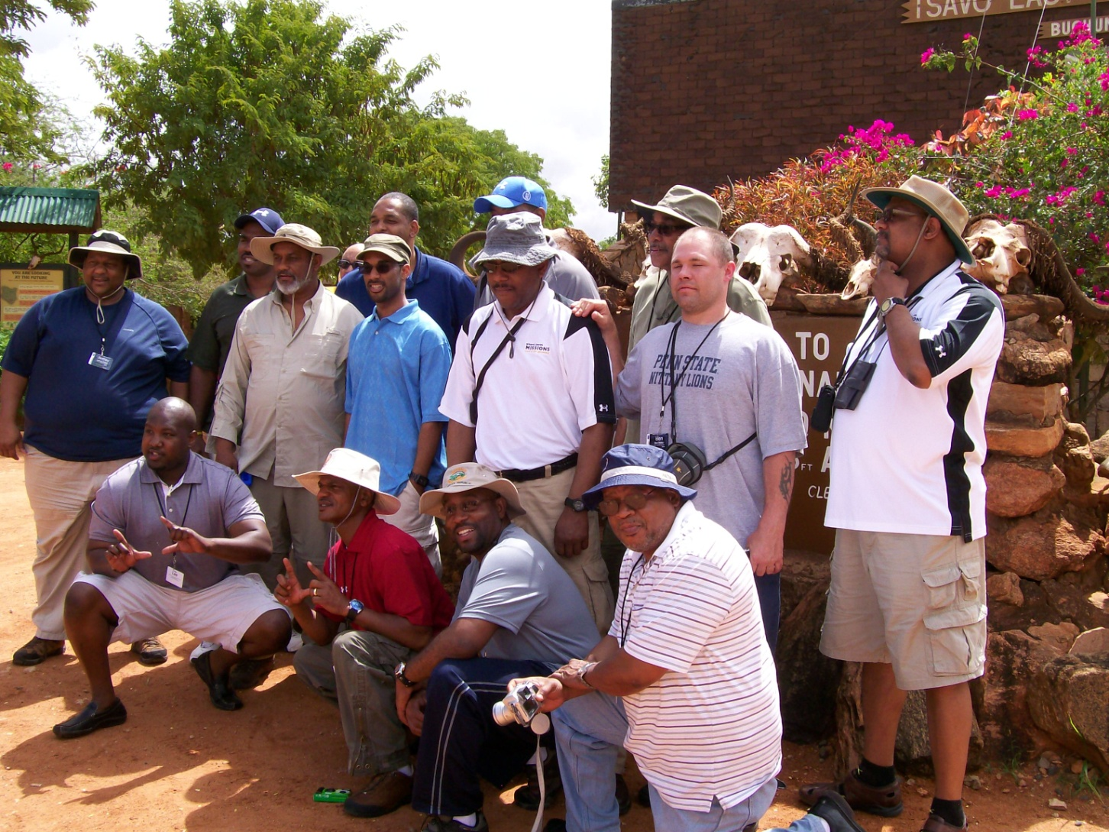
Urban Priesthood Alliance

Slide 5
Kenya Mission Trip
The Impetus
It was during the final leg of our program on a mission trip to Mombasa, Kenya. As a group we collectively sensed the Lord leading us to organize around a common vision and purpose.
One of our first objectives was to fulfill an obligation to raise funds to complete the construction on a learning center at Kwale Prison near Mombasa, Kenya.

Slide 6
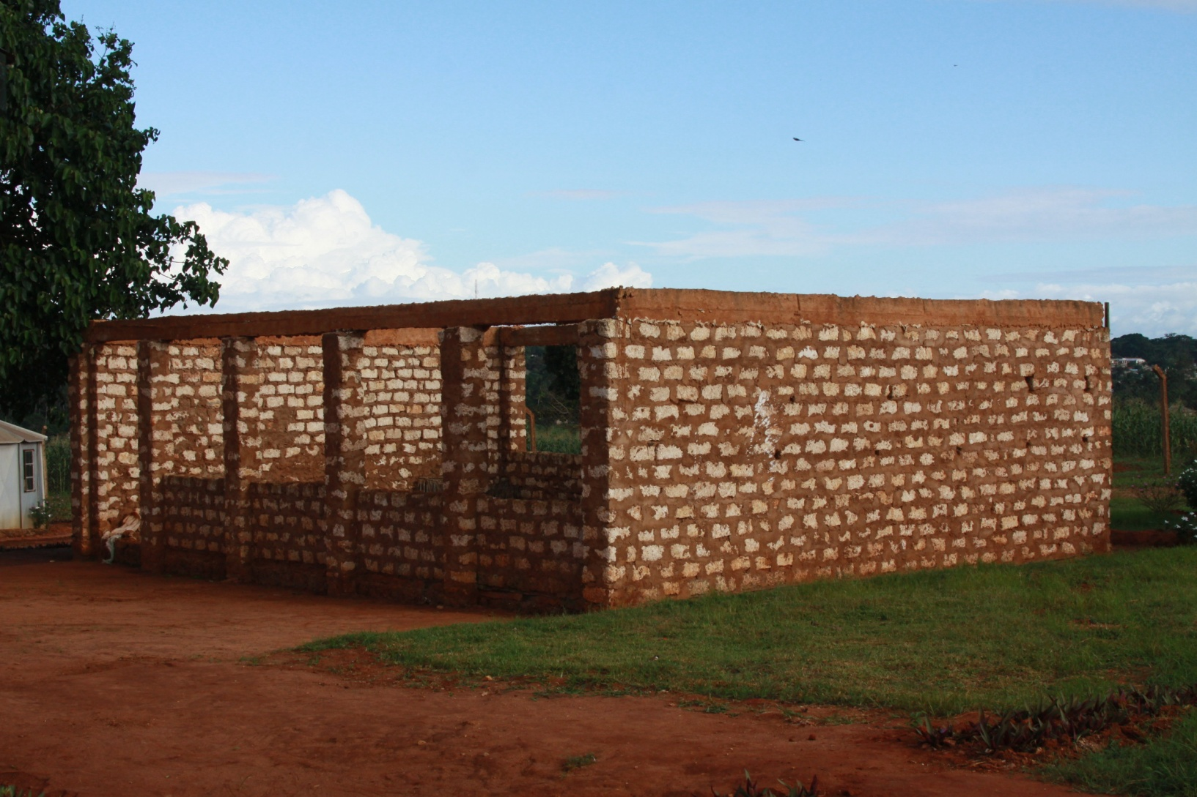
Kwale Prison - Kenya

Slide 7
UPA Purpose Statement
Missionally Engaging Churches, Communities and Continents through Christ”

Slide 8
The Great Commission &
The Great Commandment of Christ
Continents
Communities
Local Churches
Go into all the World & Make Disciples
(Matt 28:19-20)
Love God &
Love Others
(Matt 22:36-40)

Slide 9
Missional
We recognize that many churches have become consumer driven and internally focused. (Christendom)
We believe that God is on mission to redeem humanity and we wish to join Him on His mission into the world.
We believe that the church is God’s representative in the world. It is our hope that UPA can assist the church in its rediscovery of its missional call.

Slide 10

Again Jesus said, “Peace be with you! As the Father has sent me, I am sending you.” (John 20:21)

Slide 11
Future Plans
Short Term Plans
  UPA is currently in the process of establishing Non-Profit status with the State of Pennsylvania.
  Establish ourselves as a 501 (c) 3 organization to allow UPA to engage in ministry as a tax exempt body. This allows us to receive tax deductible gifts
  Raise funds to fulfill the Kwale Commitment
  Provide a support for the church at home and abroad.

Slide 12
Future Plans
Long Term Plans
  Host conferences to assist churches in their efforts to do contextual/incarnational ministry.
  Support the ministry of Word of Life Kenya by hosting future mission trips.
  Provide a network of resources for local and foreign ministry efforts. (A missional incubator)
  Continually present God’s missional heart to churches within urban contexts.

Slide 13
UPA Members
William Bounds
Kyle Canty (Secretary)
Lee Everett
Phil Ginyard (President)
James Graves (Chaplain)
Nathaniel Hall (V. Pres.)
Jeff Harley
Drew Hart
Mark Ings (Treasurer)
Thomas Jeffcoat
Alonzo Johnson
Jay Johnson
Terrell Person (Chaplain)
Kenyatta Rush
Ben Walter

